Slide 1
IPL MATCH WINNER PREDICTION
PRESENTED BY
VEENA SRI PM
DATA ANALYTICS AND DATA SCIENCE
RP 33
03-07-2025

Slide 2
OBJECTIVE
To design and validate supervised classification models, capable of predicting the winning team of an IPL match, prior to the first ball being bowled, utilizing previous match datas
OVERVIEW
Historical data - Indian Premier League
Rows - one completed IPL match
Key attributes - before the match starts, outcome - actual match

Slide 3
DATA UNDERSTANDING
Shape - (756, 18)
Records range between year 2017-2019
Numerical columns, categorical columns
Multinominal imbalance class - prediction

Slide 4
DATA CLEANING
Missing values removed
Replaced entries
Checked winning team - team 1/ team2 column
Duplicates
Encoding - categorical values
Sampling method - balance response variable
Dropping irrelevant columns

Slide 5
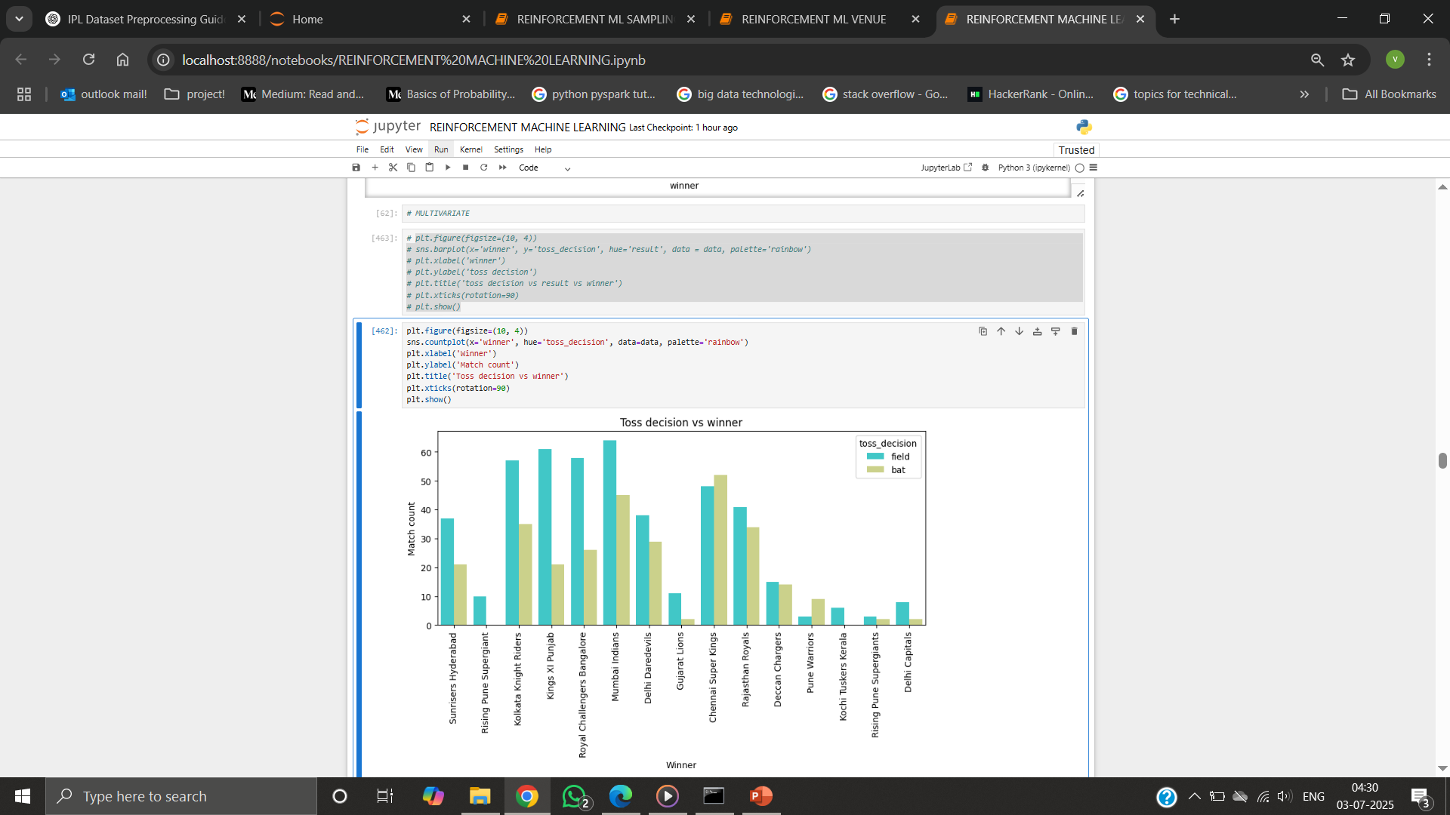
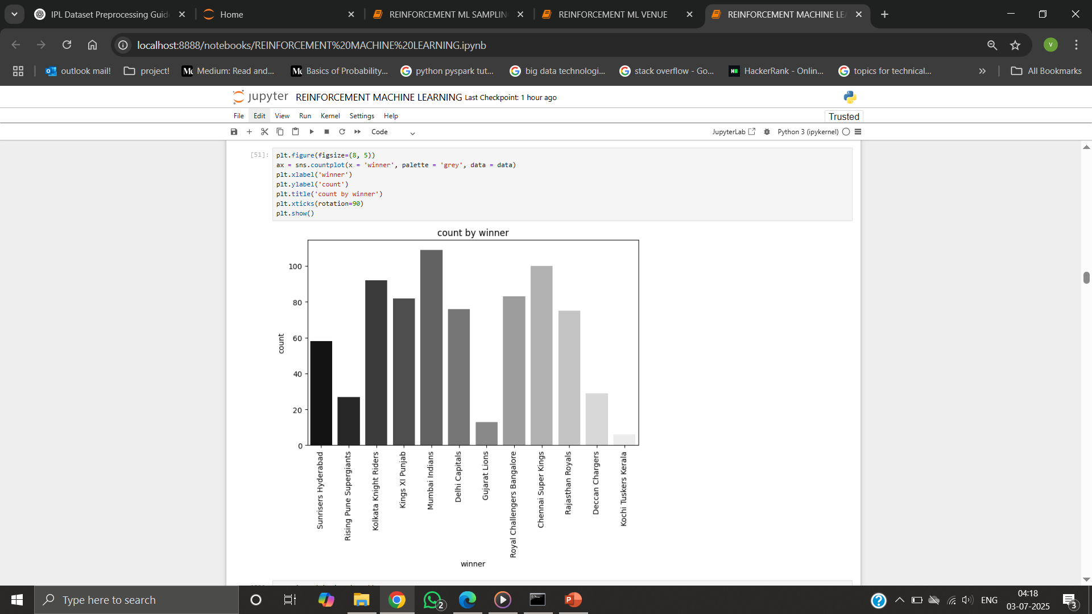
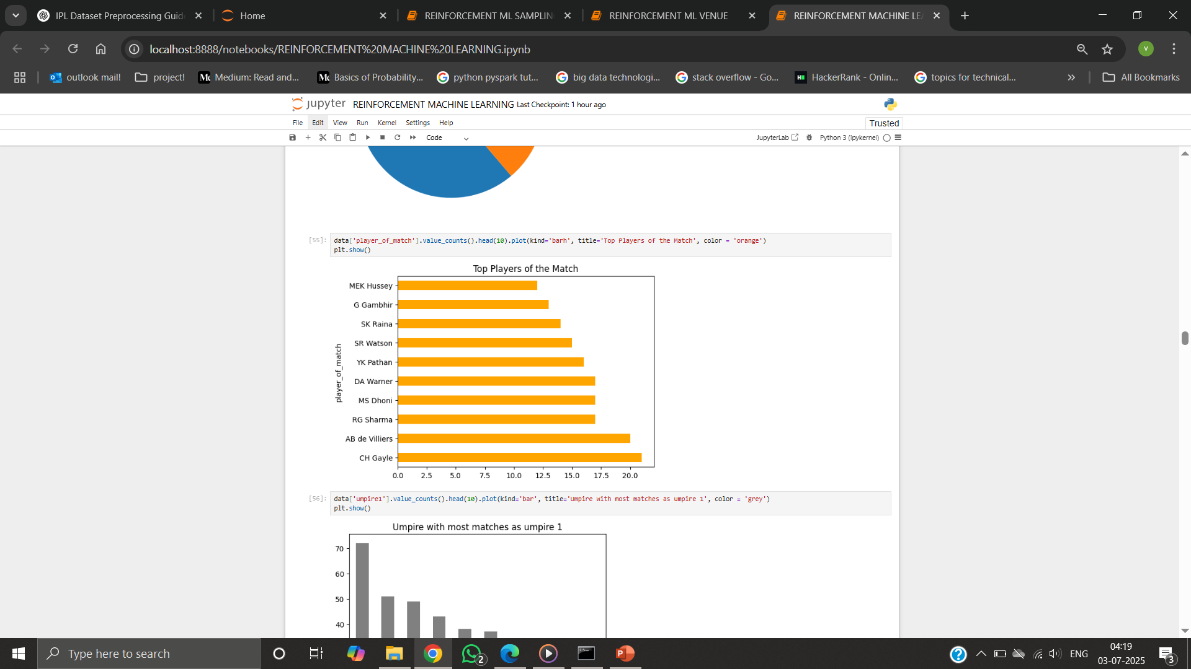
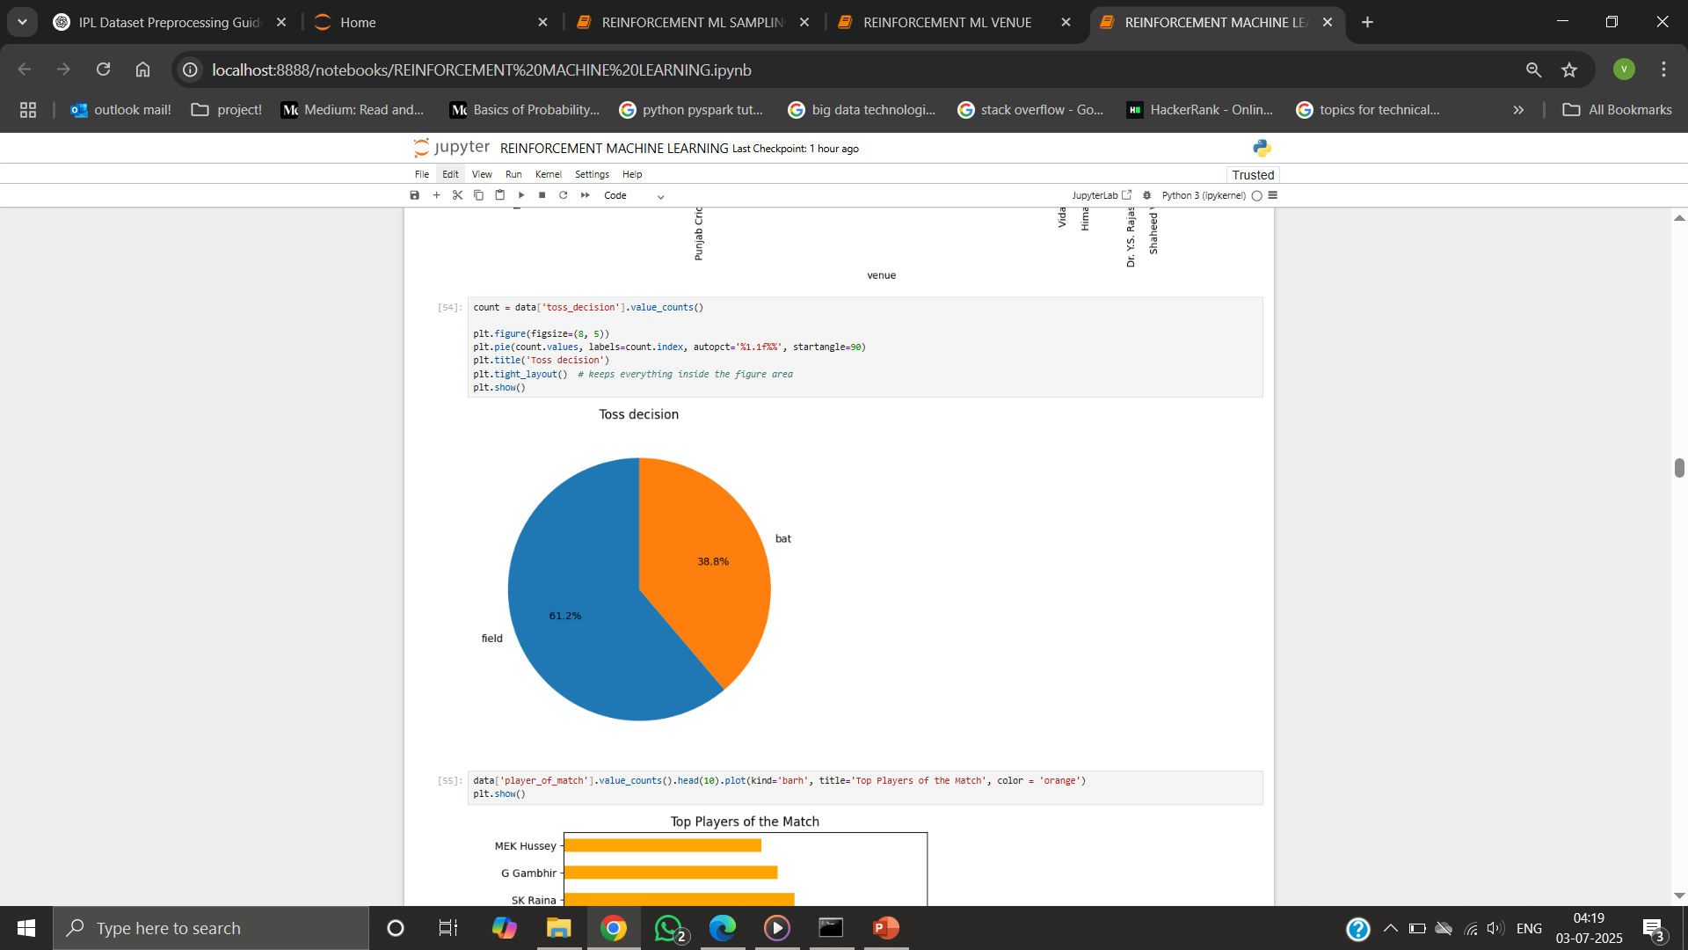
EXPLORATORY DATA ANALYSIS

Slide 6
EXPLORATORY ANALYSIS
Many teams won matches - choosing field first
Gujarat and Kochi teams frequently won by wickets
Ch Gayle repeatedly - "Player of the Match“
Mumbai Indians and Chennai Super Kings won – matches
Teams preferred - fielding first after

Slide 7
MODEL PROCESSING
Models : Logistic Regression, SVM, Random Forest, Decision Tree, Naive bayes, Xgboost
Encoding - OneHotEncoding, LabelEncoding
Sampling - SMOTE
Hyper parameter tuning - GridSearchCV
Cross validation
Evaluation metrics - Accuracy, Precision, Recall, F1 score
Difference between Crossvalidation and Test accuracy value - minimum

Slide 8
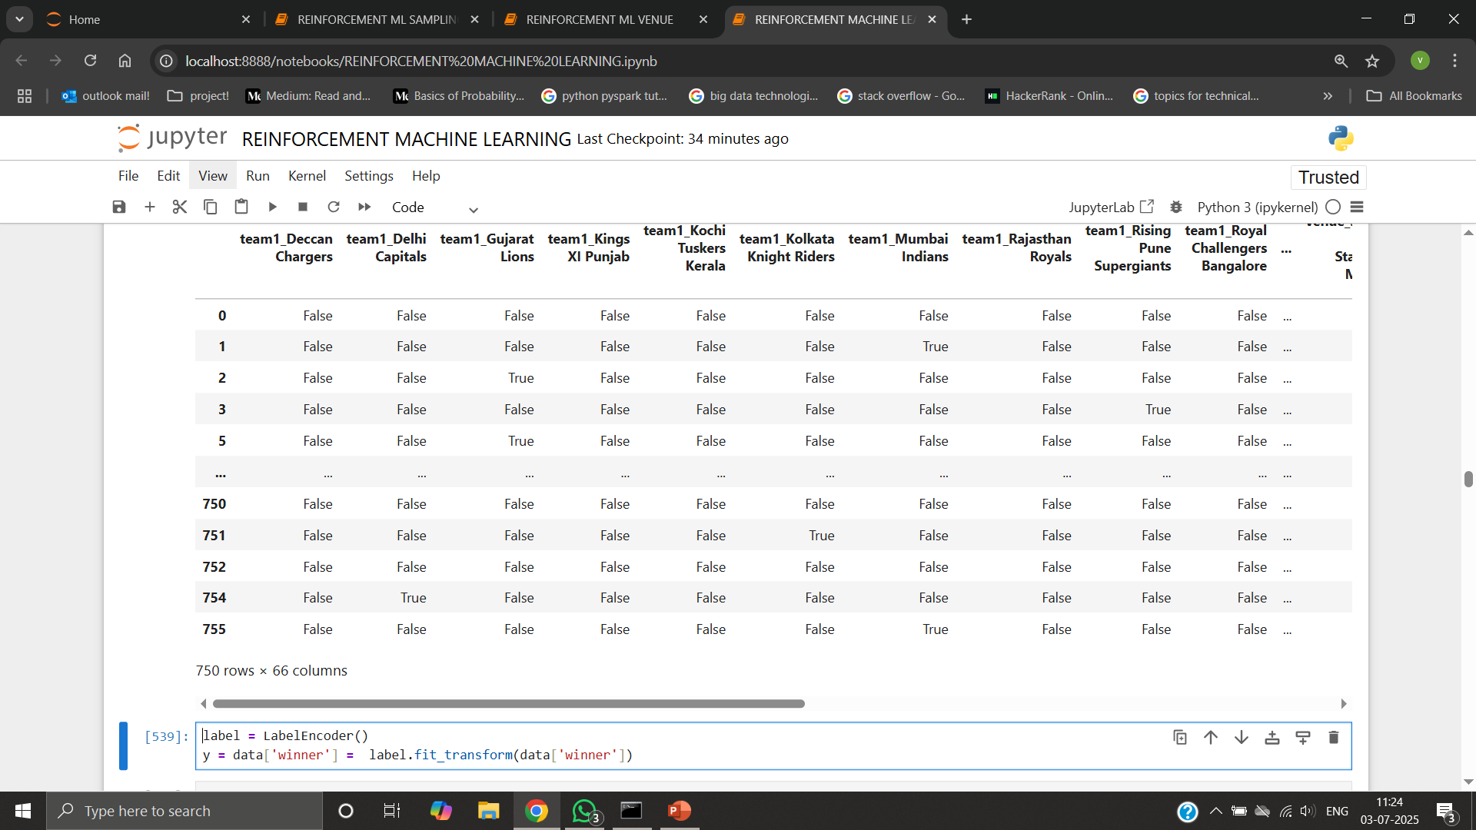
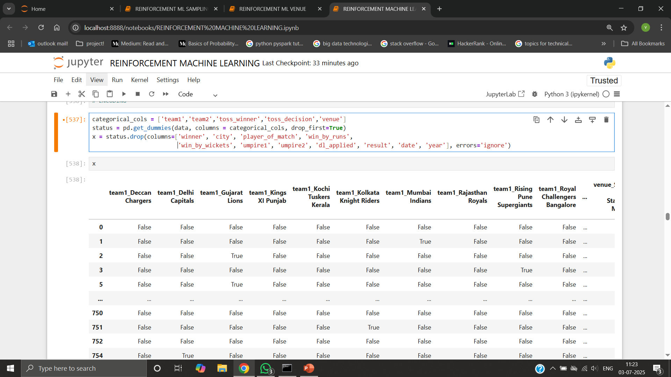
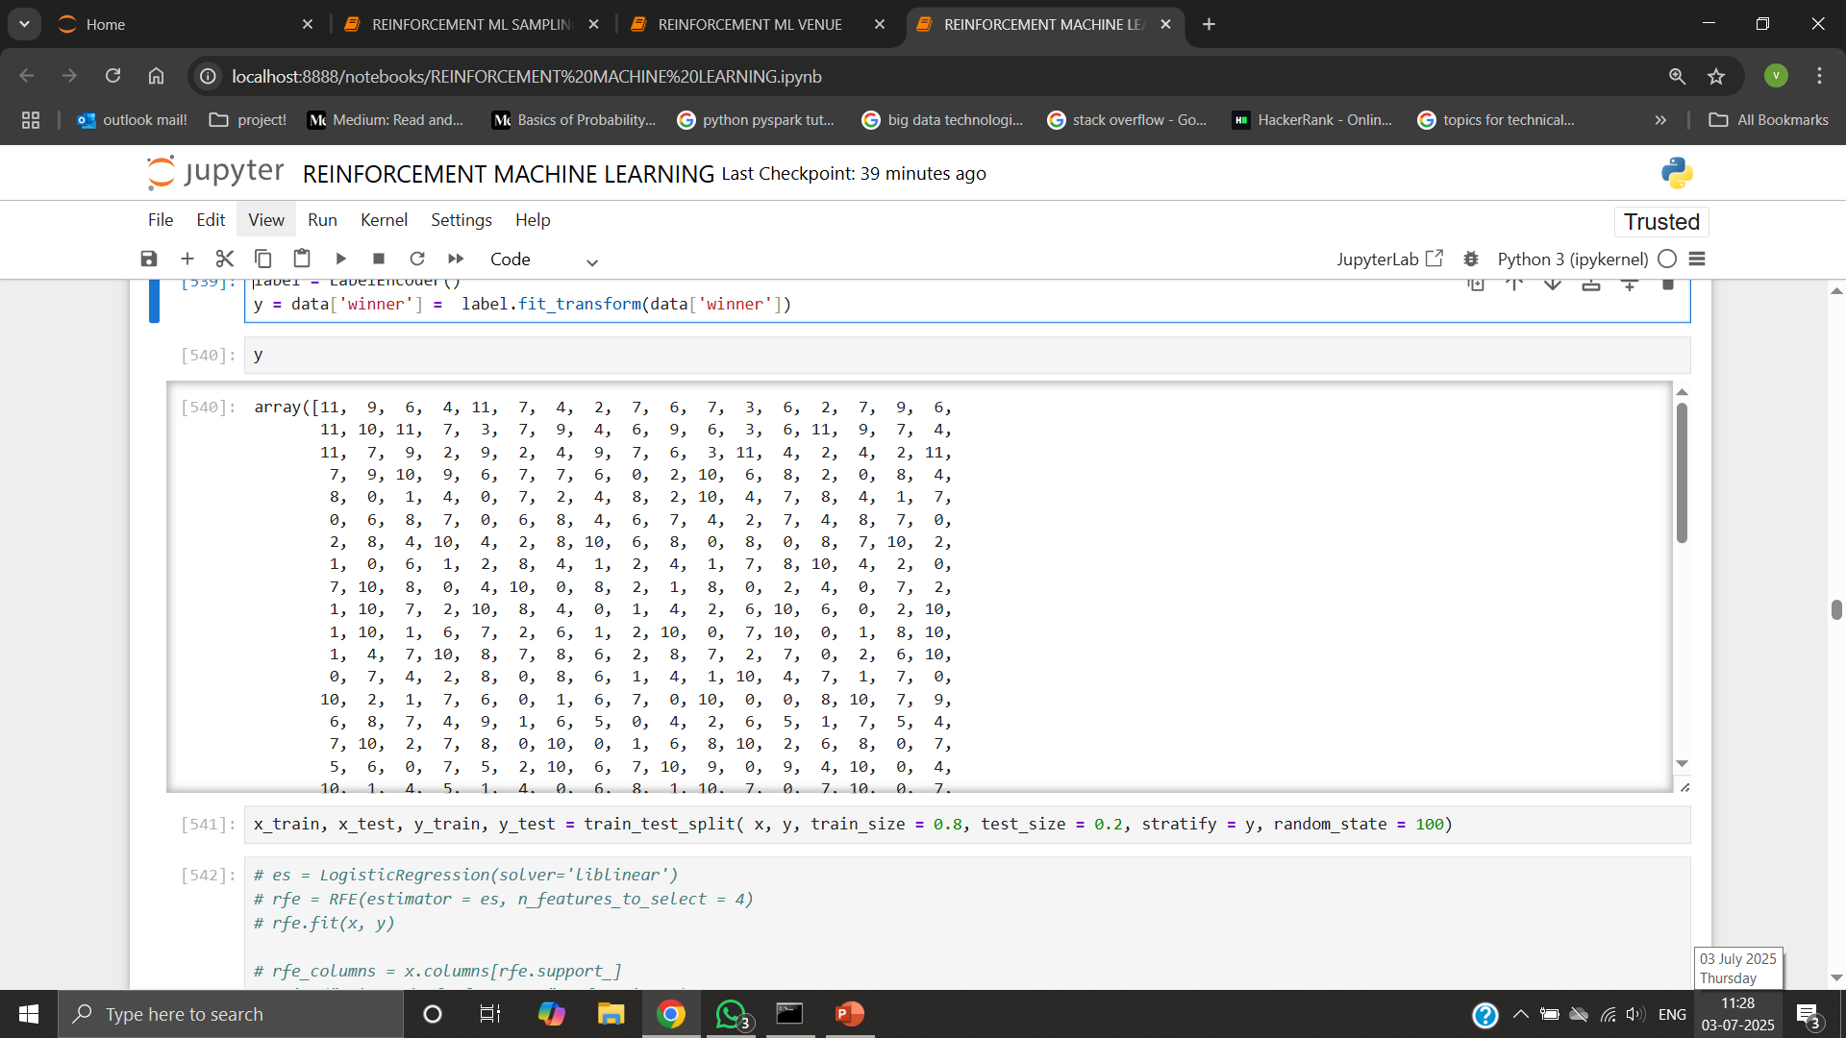
ENCODING DATA - SPLITTING
Explanatory variables - OneHotEncoding
Response variable - LabelEncoding

Slide 9
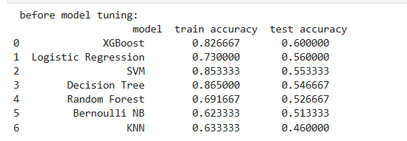
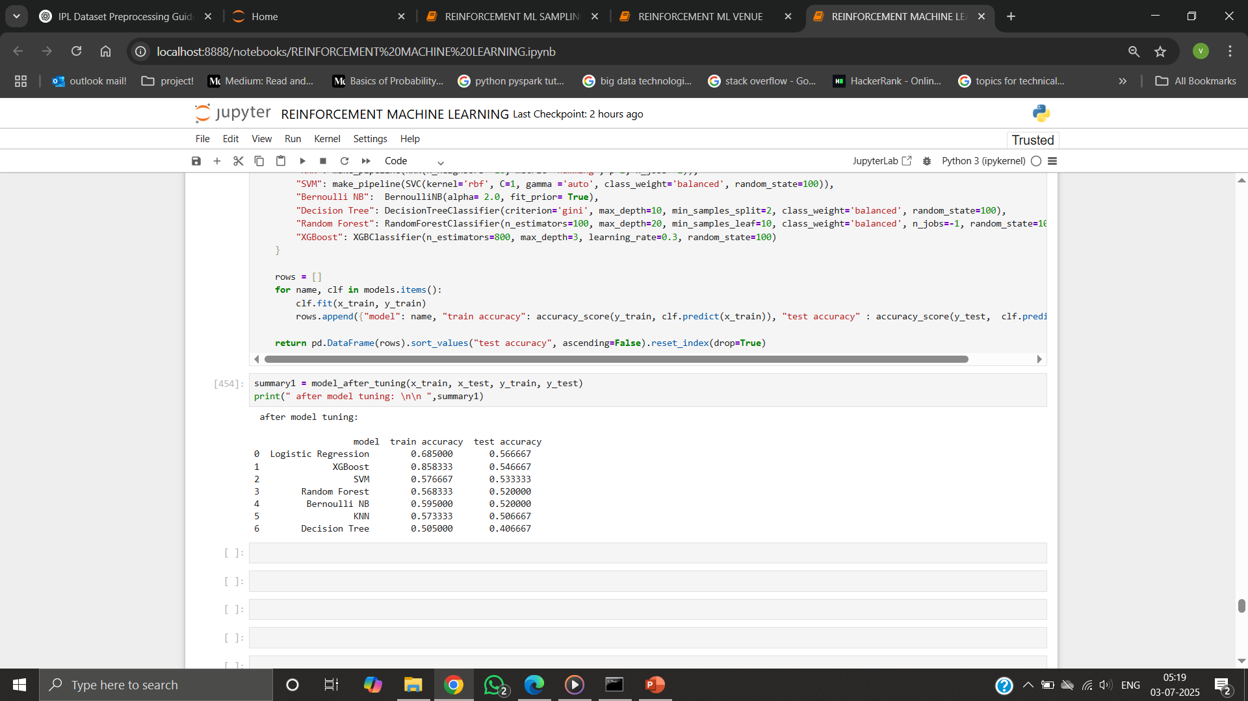
MODEL PERFORMANCE
BEFORE MODEL TUNING
Higher accuracy difference
Model overfitting
AFTER MODEL TUNING
Lower accuracy difference

Slide 10
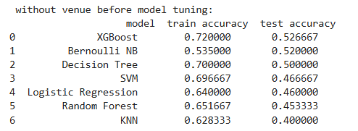
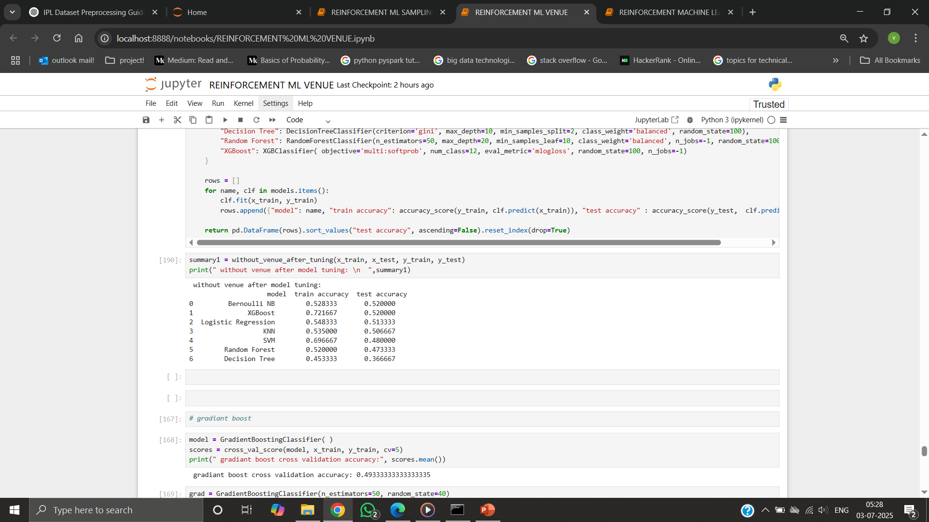
MODEL PERFORMANCE
REMOVING FEATURE VENUE - before
Difference between accuracy - lower
Optimal amount of overfitting present
REMOVING FEATURE VENUE - after
Test accuracy improved in few algorithms

Slide 11
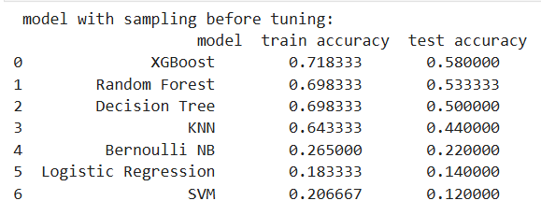
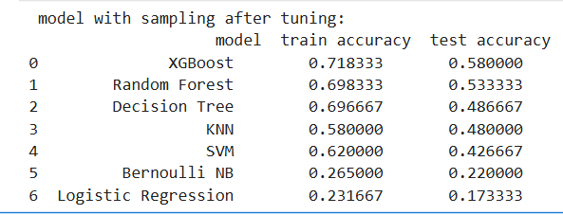
MODEL PERFORMANCE
SAMPLING - before
Imbalance class improvised
SAMPLING – after
Accuracy difference reduced

Slide 12
CONCLUSION
Data quality and preprocessing, impacts accuracy
Less data influence model learning
Hyperparameter Tuning with appropriate parameters helps improve model performance
Feature selection - crucial in avoiding redundancy
Sampling - balances class but induces noise
Xgboost has higher accuracy when compared to other models
FUTURE SCOPE
Model Deployment - Visualize predictions

Slide 13
THANK YOU

